Slide 1


A Journey from Nano-Risk to Nano-Solutions in Water Systems
Paul Westerhoff, PhD, PE, BCEE
Regents Professor
Fulton Chair of Environmental Engineering
School of Sustainable Engineering & The Built Environment
NSF Nanosystems Engineering Research Center for Nanotechnology-Enabled Water Treatment

Slide 2
20 Years of Nano Environmental Health & Safety Questions
Are engineered nanomaterials (ENMs) an emerging pollutant in water?
Do ENMs pose imminent risk in drinking water?
If society uses ENMs, where have/will they go?
What is the outcome of exposure focused researchers collaborating with toxicologists, chemists, product developers, and social scientists?
How ENM risk frameworks be used to safely develop ENM applications to reduce risks from real emerging pollutants in water?
Do nanomaterials exist, or are they just transient states?

Slide 3
Are ENMs Emerging Pollutants?
(Things in our water we know little about but scare us)
Higher Lower

Slide 4
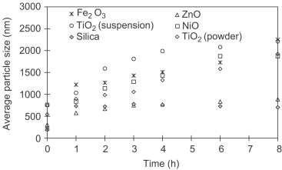
Did ENMs pose imminent risk in drinking water?
WTPs designed to remove virus, clay and other colloids. Will ENMs differ?
  No… We can use existing mechanisms and models to understand ENMs in water
Environmental engineers had limited experience with advanced material characterization tools
How do we analytically differentiate ENMs from these other particles in water at environmentally relevant concentrations?

Slide 5
If society uses ENMs, where have/will they go?
> 90% removal of Nano
From water
Low parts-per-billion of nano
mg per day
Landfill
Land
Incineration
Distribution & Premise plumbing ADD ppb levels of incidental nanoparticles
> 99% removal of nano from water
Parts-per-trillion of ENM

Slide 6
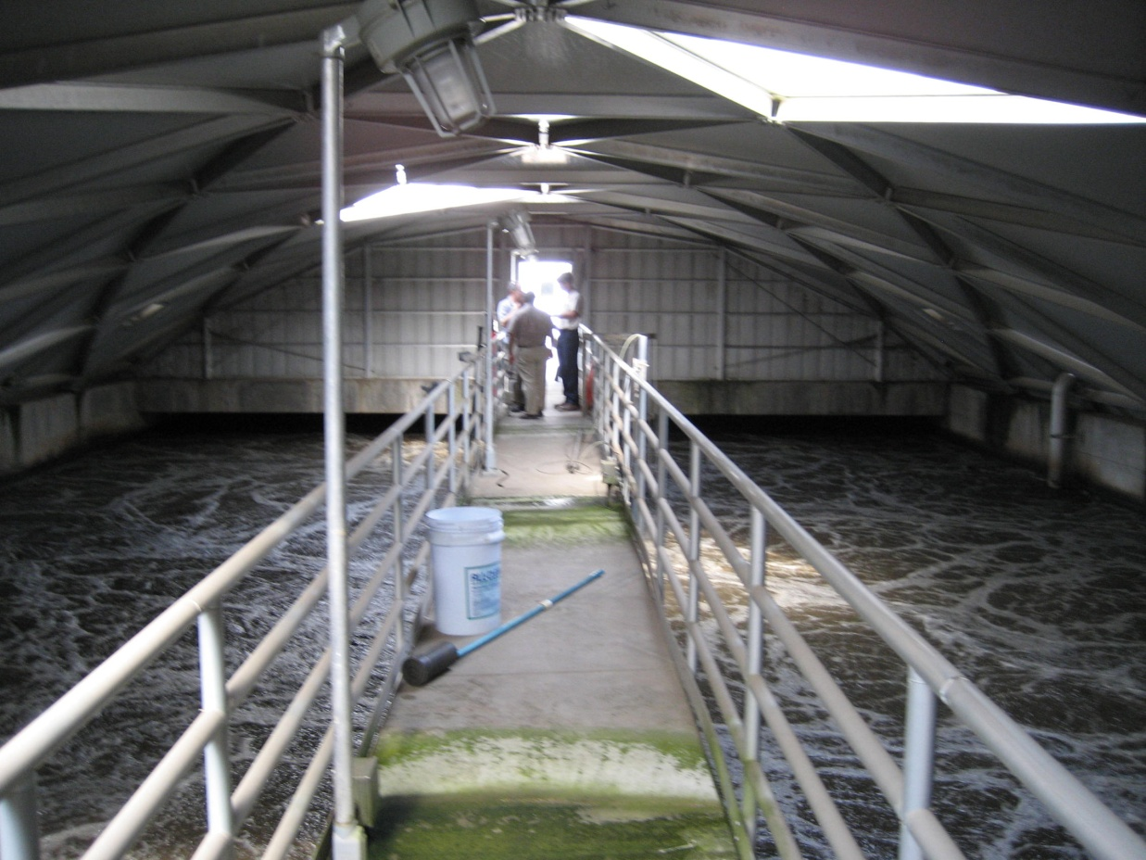
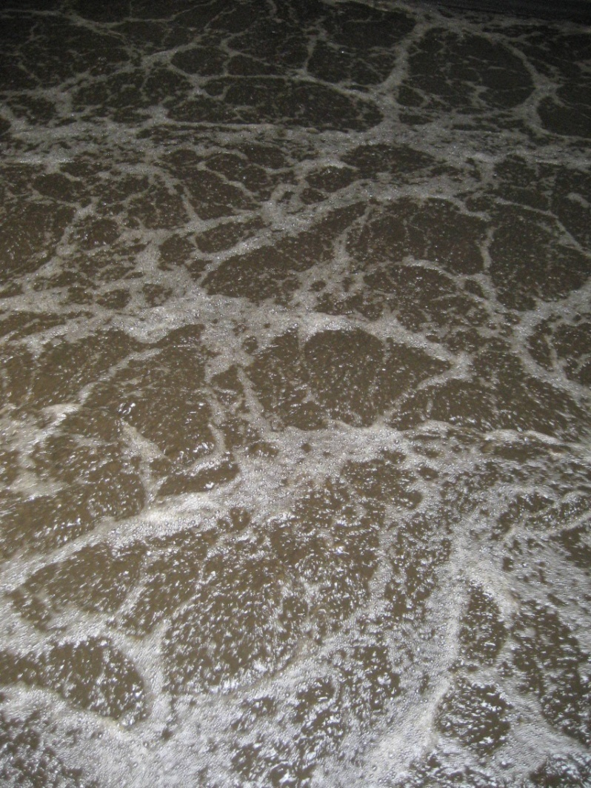
Wastewater Treatment Plants Remove > 90% of ENMs from sewage
Primary Clarify
Aeration Basin
Secondary Clarify
Tertiary Filtration
Headworks
Disinfection
Raw Sewage
2
Treated Effluent
1
4
5
3
7
6
Solids Handling
Finished Biosolids
8
Kiser et al., ES&T (2009)

Slide 7
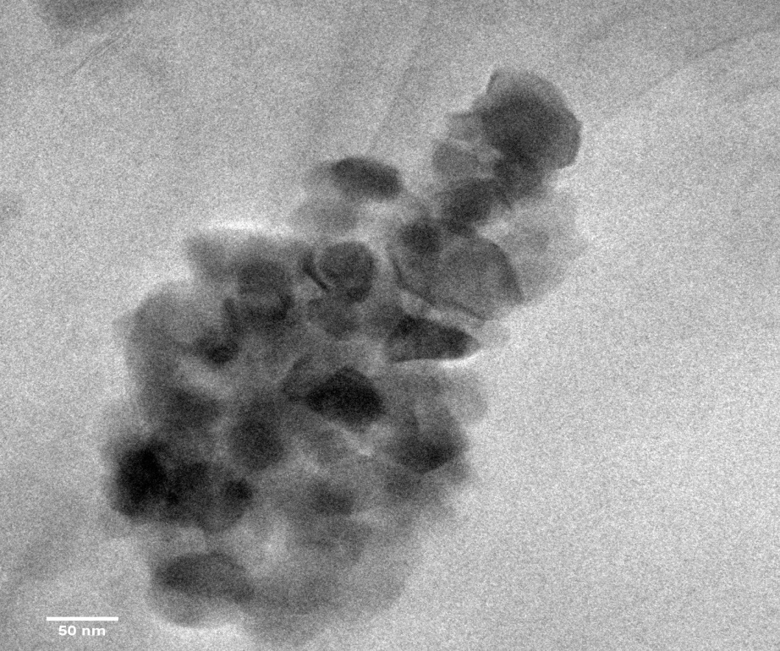
> 90% removal of Titanium at Full Scale WWTPs
Different Facilities | Titanium Content of water (ugTi/L)
 | Headworks | Effluent
Activated sludge | 615 | 5
Act. Sludge + filter | 180 | 7
Activated sludge | 363 | 3
Activated sludge | 141 | 2
Activated sludge | 581 | 18
Activated sludge |  | 8
Activated sludge | 233 | 2
Trickling filter | 549 | 13
Membrane bioreactor (MBR) | 310 | 1
MBR | 422 | 4
Average | 377 | 6
60 ± 12 nm

Slide 8
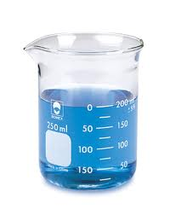
OPPTS 835.1110 Activated Sludge Sorption Isotherm
Fresh biomass
NP + 400 mg TSS/L Biomass Sorbent
Nanoparticle Control
(No Biomass Sorbent)
NP + 800 mgTSS/L Biomass Sorbent

Slide 9
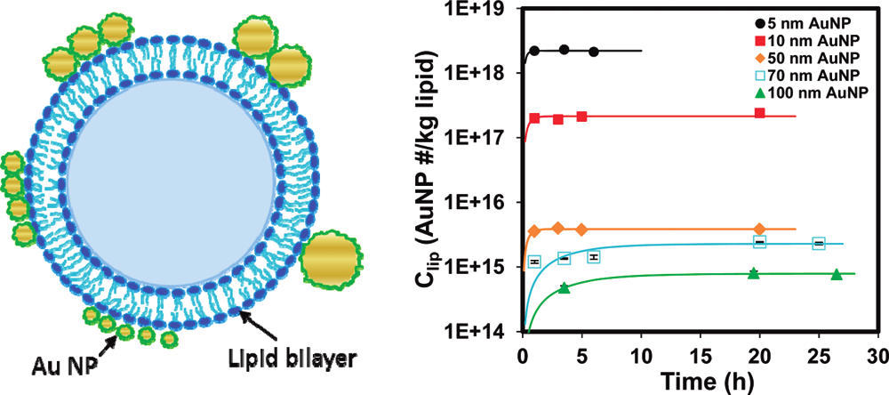
Why do ENMs behave different from chemicals at WWTPs
Hou et al., ES&T (2012)
Kiser et al., ES&T (2012)

Slide 10
Daily ENM additions to continuous flow wastewater systems exhibit only short-term impacts
Yang et al., Chemosphere 2015
Notes:
A sequencing batch reactor was operated for 1 year. Nanoparticles were added daily with fresh feed solutions. Initial very high removal of nanoparticles at TSS levels representative of activated sludge, made us reduce COD substrate allowing us to operate at a lower TSS level to see quantifiable removals of fullerenes (C60) or nanosilver (functionalized Ag). During periods we simultaneously added 2 types of nanoparticles (C60 and nanosilver), and repeated the patterns. For the first day or two upon adding nanoSilver, bacteria were killed – but continuous daily addition allowed “other” bacteria to grow. We were able to repeat this trend. At 2 g TSS/L – there was only a small impact on biomass concentrations upon addition of nanosilver. The CONCLUSIONs are 1) nanoparticles are well removed in growing cultures of bacteria in a SBR (and presumably in a continuous flow activated sludge system), 2) very high removals of nanoparticles are expected at 2 g TSS/L, 3) short-term impacts on biomass density and possibly microbial diversity may occur upon addition of nano-silver – but probably no different than an equal spike of ionic silver.

Slide 11
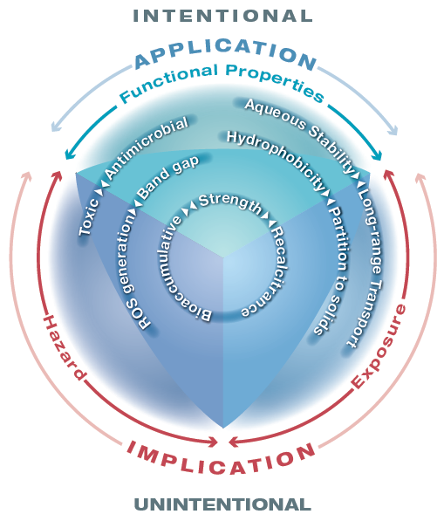
What is the outcome of exposure focused researchers collaborating with toxicologists, chemists, product developers, and social scientists?

Slide 12
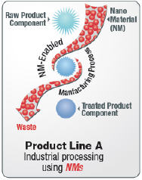
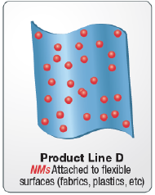
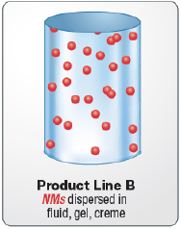
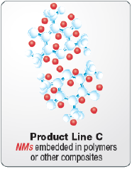
Groupings of Nano-Enabled Products
Applications & Functionality
Reactive
NMs
CeO₂ in
Polishing
Agents
Ag⁰ clothing
“Free”
NMs
Embedded
NMs
SiO₂ in
Foods
SiO₂ in floor
coatings
Passive
NMs

Slide 13
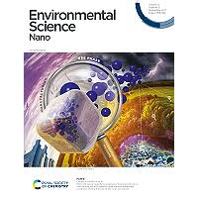
How do you Detect Nanoparticles in Wastewater, Rivers or Drinking water Water?

Slide 14
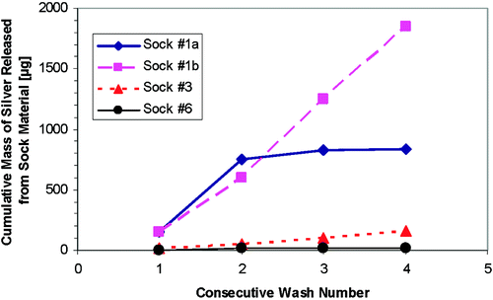
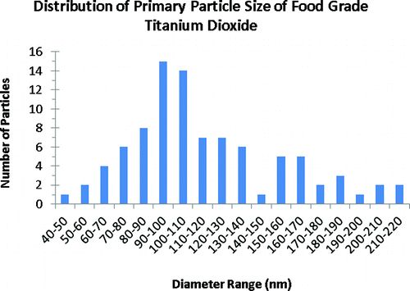
Advancing Nanoparticle Detection
Characterization + Quantification in “REAL” world samples
  Ag⁰ in socks… and other textiles
  TiO₂ in food
  SiO₂ in foods
  TiO₂, ZnO in sunscreens
  Calcium-P nanorods in infant formula
  CNTs in paints
  SiO₂ in floor coatings
  ...and many more
Article Views: 11564 16965
Altmetric: 80 215
Citations: 1213 1143

Slide 15
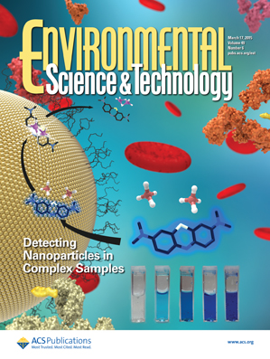
Not characterization – but quantification at low levels in environmental samples
Advanced measurement and data processing using existing instrumentation:
  Metal-based ENMs using single-particle ICP-MS
  Carbon nanotubes using programmable thermal analysis
  Fullerols using LC-MS-MS
Advanced methods to extract ENMs from complex matrices:
  Rat lungs
  Food products
  Wastewater biomass …
Developed new analytical tools
  Colorimetric detection of catalytic ENM properties

Slide 16
We apply ENM risk frameworks to safely develop ENM applications to reduce risks from real emerging pollutants in water – instead of thinking of ENMs as emerging pollutants

Slide 17
NEWT Vision
Over 25 industry & innovation partners ranging in size from 2 to > 20,000 employees
NEWT will enable access to affordable, adequately treated water almost anywhere, by developing transformative & decentralized modular treatment systems empowered by nanotechnology that protect human lives and support economic development.
Notes:
NEWT is contributing to water security through innovative research, education, and broad participation in collaboration with industry.
Our center vision is to enable access to adequately treated and affordable clean water almost anywhere in the world, by developing next-generation modular treatment systems that are empowered by nanotechnology so that they are small and easy to deploy and have superior treatment capacity to tap just about any water source or treat challenging industrial wastewaters to protect human lives and support economic development.
Thus, our mission is to develop a diverse, globally-competitive workforce, a dynamic innovation ecosystem, and novel, cost-effective materials and technologies that enhance water security.

Slide 18
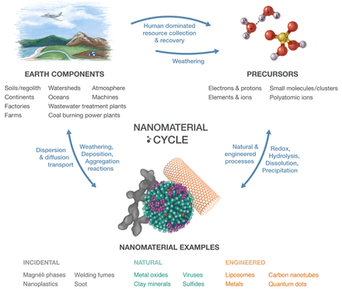
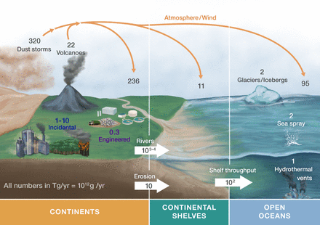
Do nanomaterials exist, or are they just transient states? What role do they play in life?
Hochella et al., Science 363, 1414 (2019)

Slide 19
Lessons from 20 years of nano-EHS research, workshops,…
ENMs in water were an emergent pollutant
    We defined the problem
    We understand how to manage the risk
    Guidelines, frameworks, standards are under development
ENMs move through society, already exist in our environment, and we know where and how to find them
Nano-EHS research require(s) collaboration across many disciplines and needs convergent research to recognize the potential to transform societies
Using ENMs to address environmental challenges
    Leverages unique nanoscale properties to create chemical-free water treatment solutions that enable decentralized treatment
    Requires immobilization in macroscale structures to limit use of “fairy dust” approaches
We know VERY LITTLE about how nature uses nanomaterials (e.g., catalysis in heterogeneous and dilute solutions at room temperature)

Slide 20
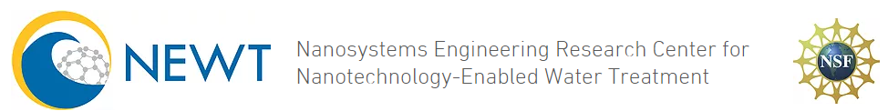

Acknowledgements
Many graduate students, post-docs and wonderful interdisciplinary collaborators across the globe
http://www.newtcenter.org/
https://lc-nano.engineering.asu.edu/
http://ncisouthwest.org/
Contact
p.westerhoff@asu.edu
RES018801Z & P42ES030990
Cognitive aging, remediation and exposure sources (MEMCARE) center

