Slide 1
DNA Strand Displacement driven Molecular Additive Manufacturing (DSD-MAM)
William Shih, Dana-Farber Cancer Institute
DOE-AMO funded project (2018 July – 2021 December)
2018 NSF Progress in Nanotechnology Meeting

Slide 2
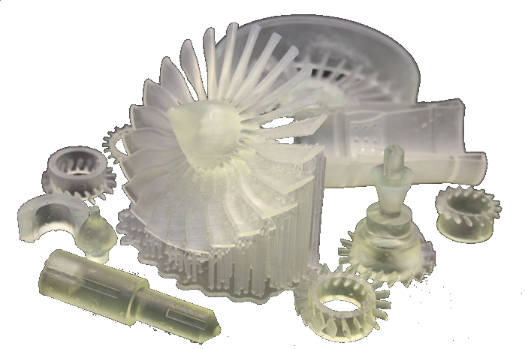
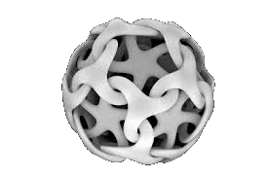
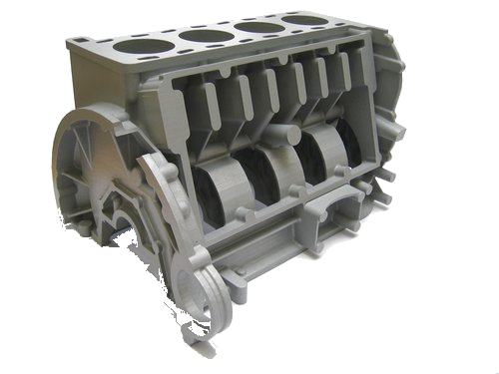
Rapid Macroscale Prototyping
Design cycle < 1 day
Only one at a time
Rapid Nanoscale Prototyping?
Design cycle < 1 day?
1 trillion at a time?

Slide 3
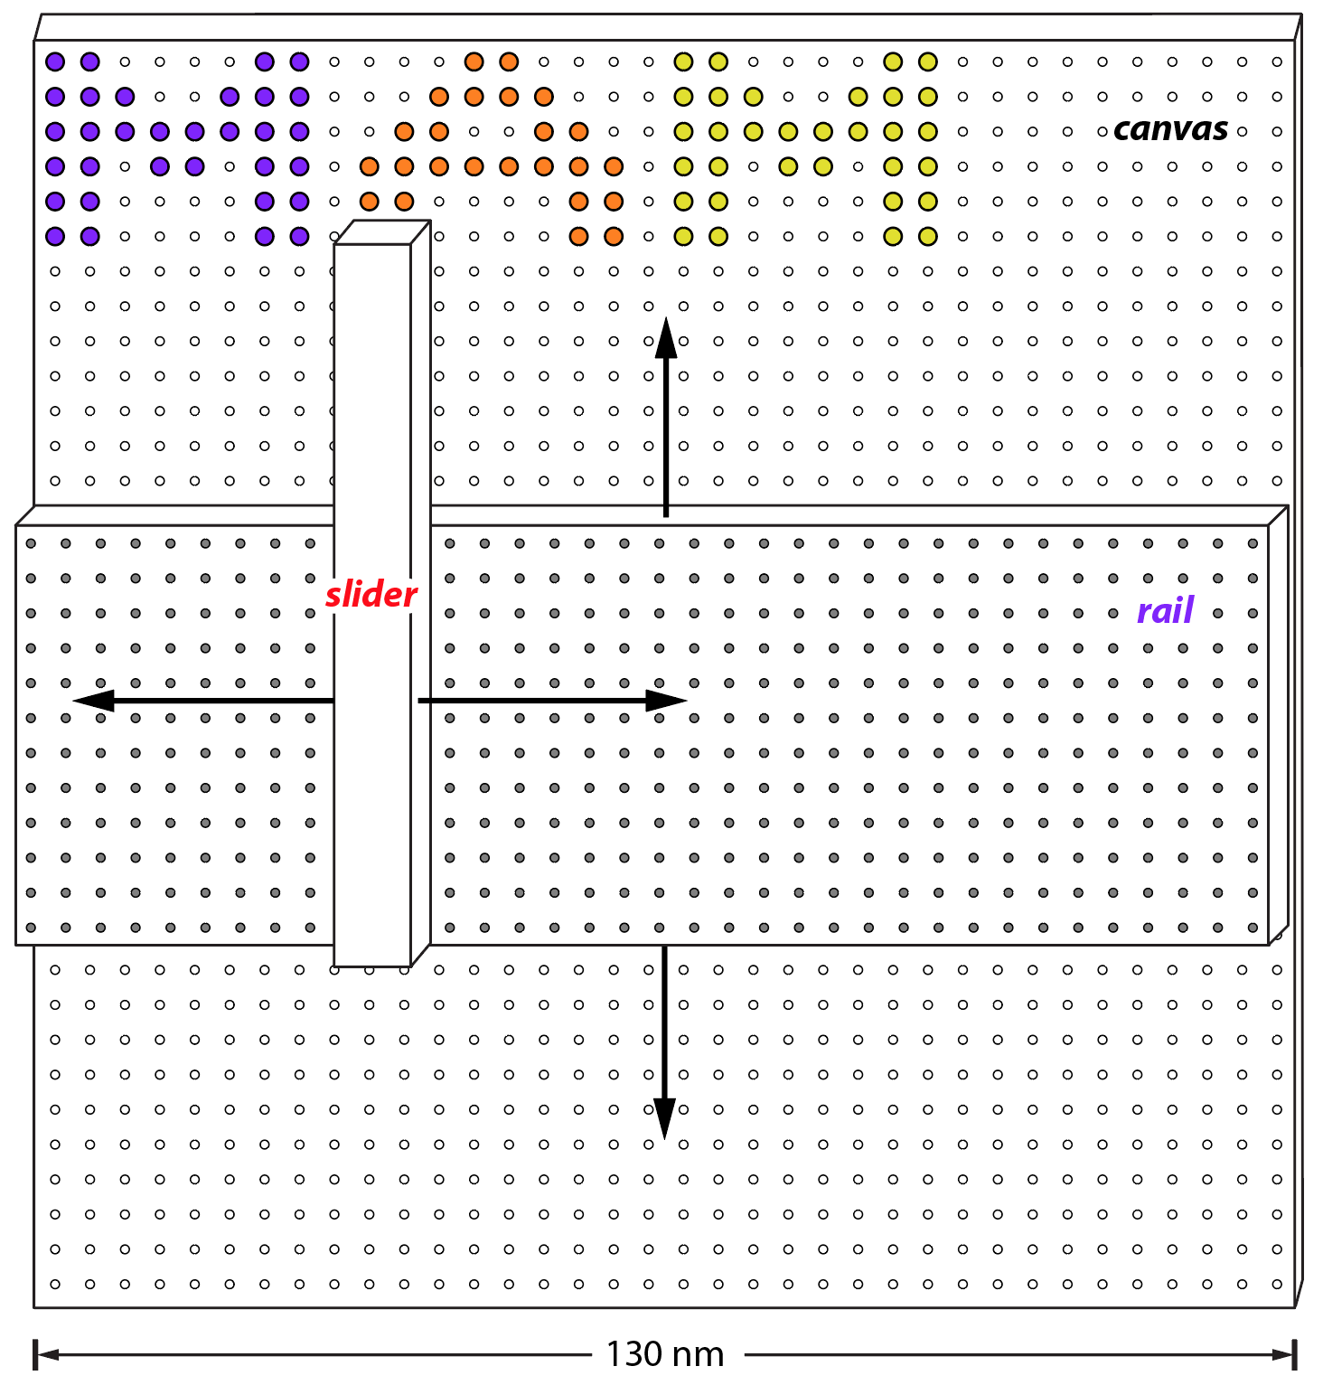
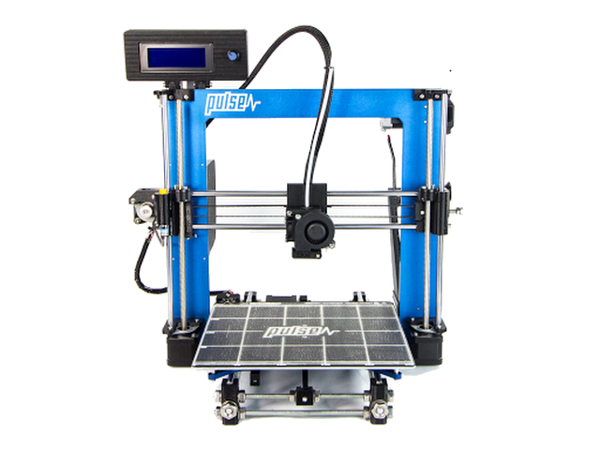
Macroscale 3D Printing
DNA-based 2D Printing by 2021? (3.5 nm pitch)
Z
Y
X
https://3dprinting.com/

Slide 4
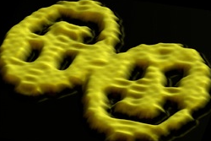
scaffolded DNA origami → ~100 nm shapes
Rothemund PW Nature 440, 297–302, 2006.
100 nm
Notes:
However, there’s a key limitation in the field...
DNA origami is limited by the size of scaffold DNA from which it is folded. Origami users fold structures from the purified, circular M13 phage genome and this affords us enough DNA to fold objects where single dimensions are maximally ~100-500 nm.
What are we to do as designers if our ultimate application requires bigger structures yet?

Slide 5
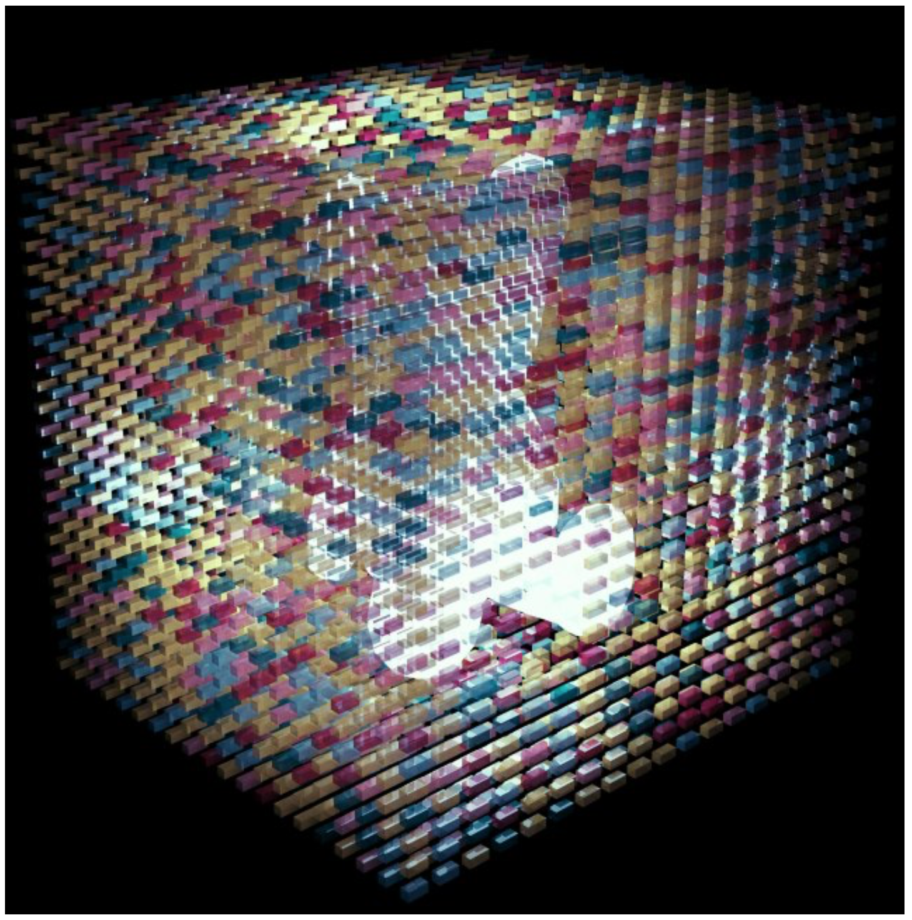
unique (2.5 nm)³
DNA bricks/voxels
(100 nm)³
DNA sculpture

Slide 6
Demonstrated 32 steps with 97% yield per step

Slide 7
Three-phase stepper motor
actuated by pulses of short DNA strands
Cooperative stepping with short bridging strands?
Integration of steppers along two axes?
Integration of deposition functionality?
3.5 nm
animation by Luzia Kilwing

Slide 8
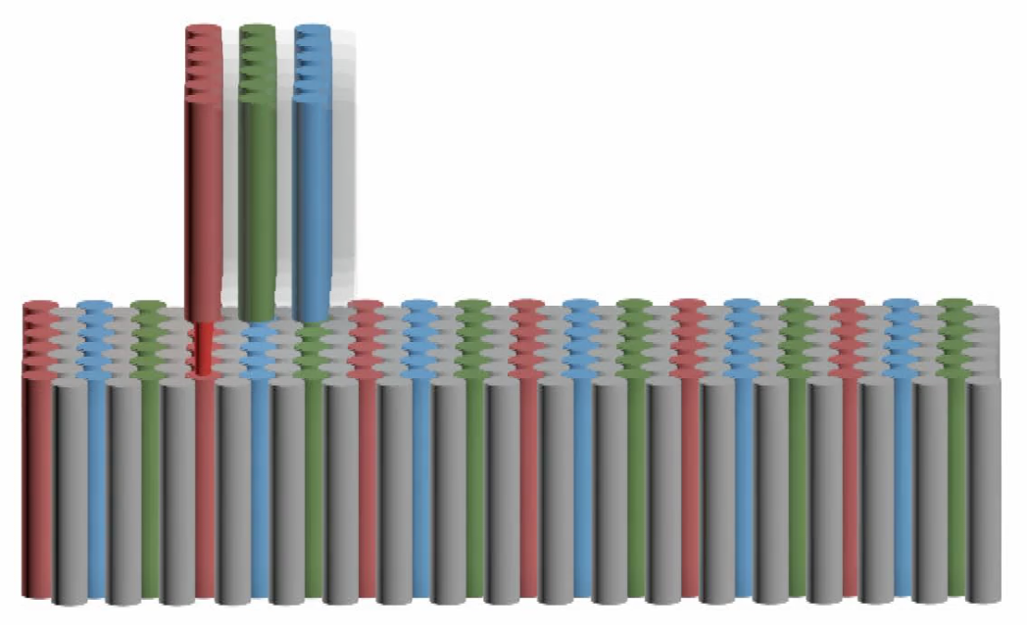
Three-phase stepper motor
actuated by pulses of short DNA strands
3.5 nm
Track with three flavor overhangs

Slide 9
Luzia Kilwing
Three-phase stepper motor
actuated by pulses of short DNA strands
3.5 nm

Slide 10
Three-phase stepper motor
actuated by pulses of short DNA strands
3.5 nm

Slide 11
Three-phase stepper motor
actuated by pulses of short DNA strands
3.5 nm

Slide 12
Three-phase stepper motor
actuated by pulses of short DNA strands
3.5 nm

Slide 13
Three-phase stepper motor
actuated by pulses of short DNA strands
3.5 nm

Slide 14
Three-phase stepper motor
actuated by pulses of short DNA strands
3.5 nm

Slide 15
Three-phase stepper motor
actuated by pulses of short DNA strands
3.5 nm

Slide 16
Three-phase stepper motor
actuated by pulses of short DNA strands
3.5 nm

Slide 17
Three-phase stepper motor
actuated by pulses of short DNA strands
3.5 nm

Slide 18
Three-phase stepper motor
actuated by pulses of short DNA strands
3.5 nm

Slide 19
Three-phase stepper motor
actuated by pulses of short DNA strands
3.5 nm

Slide 20
Three-phase stepper motor
actuated by pulses of short DNA strands
3.5 nm

Slide 21
Three-phase stepper motor
actuated by pulses of short DNA strands
3.5 nm

Slide 22
Three-phase stepper motor
actuated by pulses of short DNA strands
3.5 nm

Slide 23
Three-phase stepper motor
actuated by pulses of short DNA strands
3.5 nm

Slide 24
Three-phase stepper motor
actuated by pulses of short DNA strands
3.5 nm

Slide 25
Three-phase stepper motor
actuated by pulses of short DNA strands
3.5 nm

Slide 26
Three-phase stepper motor
actuated by pulses of short DNA strands
3.5 nm

Slide 27
Three-phase stepper motor
actuated by pulses of short DNA strands
3.5 nm

Slide 28
Three-phase stepper motor
actuated by pulses of short DNA strands
3.5 nm

Slide 29
Three-phase stepper motor
actuated by pulses of short DNA strands
3.5 nm

Slide 30
Three-phase stepper motor
actuated by pulses of short DNA strands
3.5 nm

Slide 31
Three-phase stepper motor
actuated by pulses of short DNA strands
3.5 nm

Slide 32
Three-phase stepper motor
actuated by pulses of short DNA strands
3.5 nm

Slide 33
Three-phase stepper motor
actuated by pulses of short DNA strands
3.5 nm

Slide 34
Three-phase stepper motor
actuated by pulses of short DNA strands
3.5 nm

Slide 35
Three-phase stepper motor
actuated by pulses of short DNA strands
3.5 nm

Slide 36
Three-phase stepper motor
actuated by pulses of short DNA strands
3.5 nm

Slide 37
Three-phase stepper motor
actuated by pulses of short DNA strands
3.5 nm

Slide 38
Three-phase stepper motor
actuated by pulses of short DNA strands
3.5 nm

Slide 39
Three-phase stepper motor
actuated by pulses of short DNA strands
3.5 nm

Slide 40
Three-phase stepper motor
actuated by pulses of short DNA strands
3.5 nm

Slide 41
Three-phase stepper motor
actuated by pulses of short DNA strands
3.5 nm

Slide 42
Three-phase stepper motor
actuated by pulses of short DNA strands
3.5 nm

Slide 43
Three-phase stepper motor
actuated by pulses of short DNA strands
3.5 nm

Slide 44
Three-phase stepper motor
actuated by pulses of short DNA strands
3.5 nm

Slide 45
Three-phase stepper motor
actuated by pulses of short DNA strands
3.5 nm

Slide 46
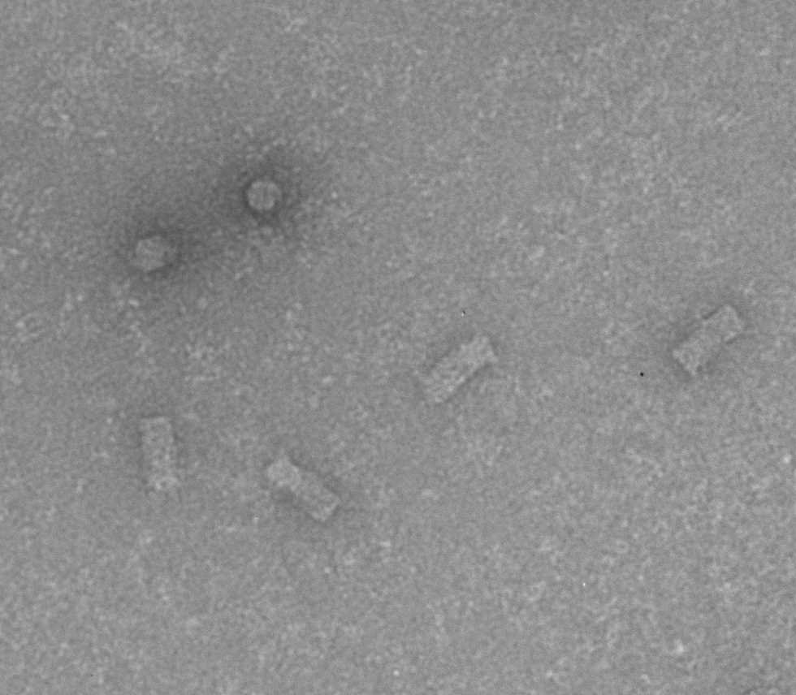
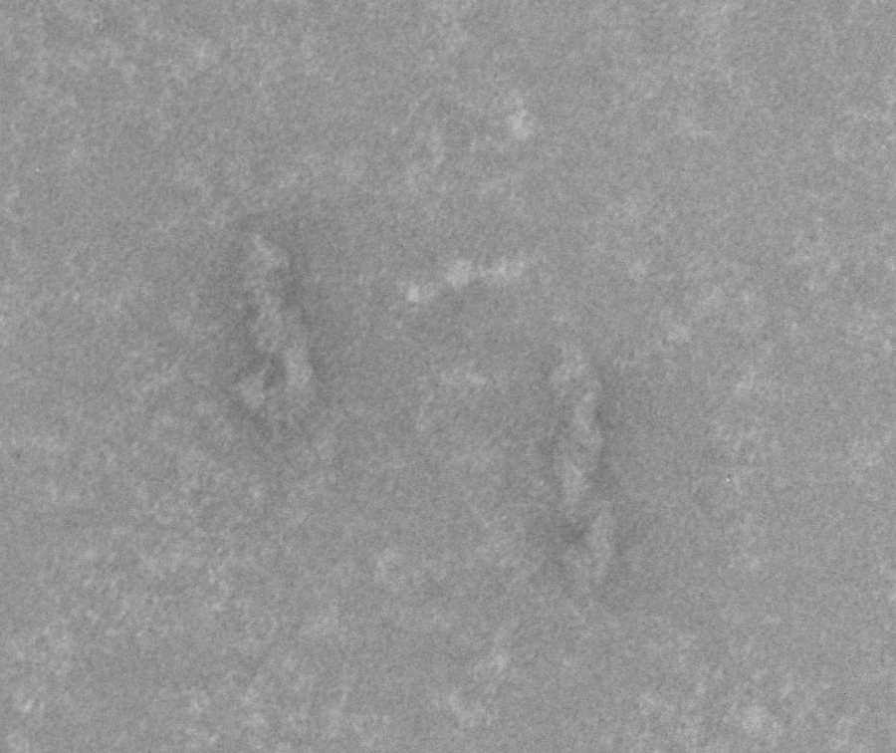
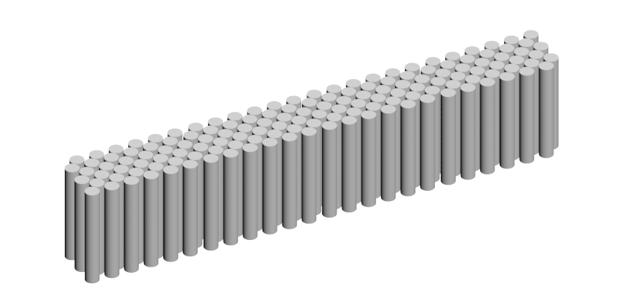
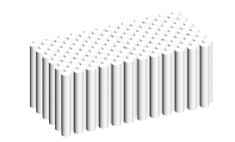
Luzia Kilwing
15 nm
30 nm
17 nm
17 nm
120 nm
144 double helices each
60 nm

Slide 47
Three-phase stepper motor
actuated by pulses of short DNA strands
Cooperative stepping with short bridging strands?
Integration of steppers along two axes?
Integration of deposition functionality?
3.5 nm

Slide 48
Near-term challenges
High-failure rate (e.g. missed steps, getting stuck, missing pixels, unwanted pixels)
Slow operation (< 0.1 – 1 Hz)
Near-term applications
Massively parallel single-molecule biophysics
Polymer library synthesis
Long-term applications of Atomically Precise Manufacturing
photovoltaics; photosynthetic and fuel cells; thermoelectrics and anisotropic heat spreaders; solid-state lighting; molecular electronic and plasmonic circuits; selectively permeable membranes; self-repairing materials with high strength-to-weight and fracture resistance.

