Slide 1
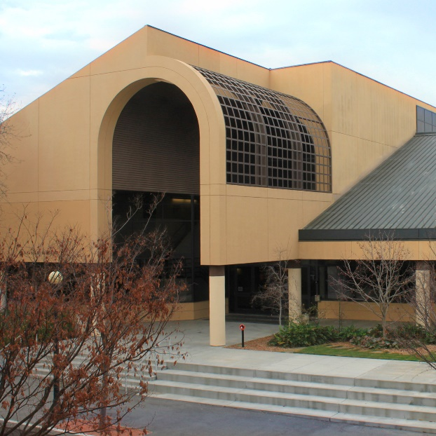
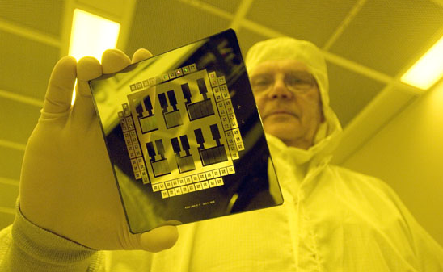
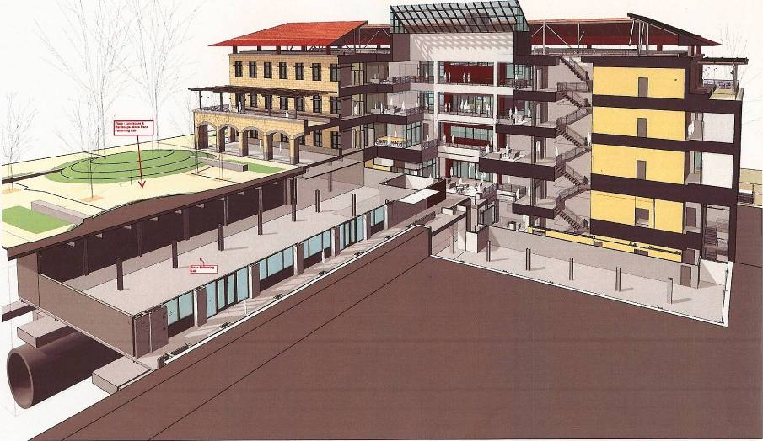
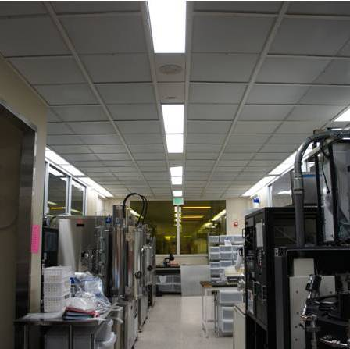
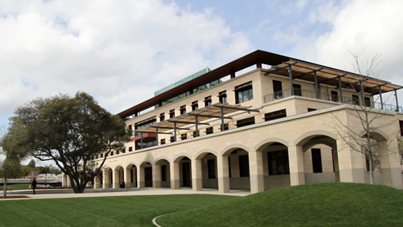
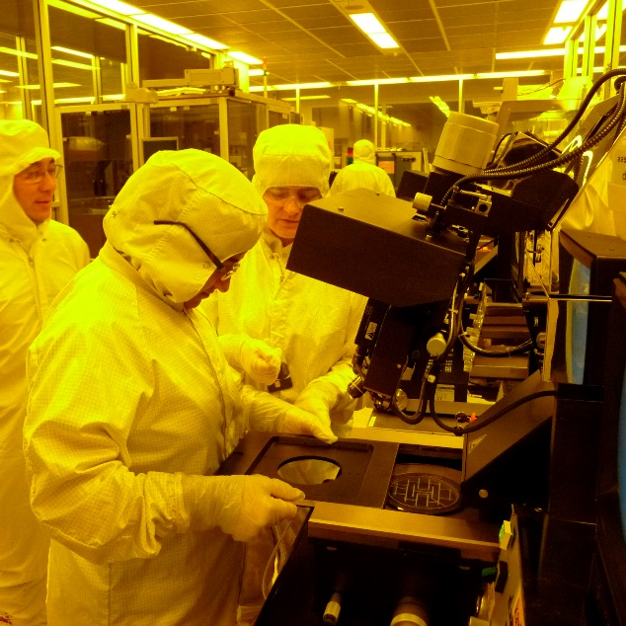
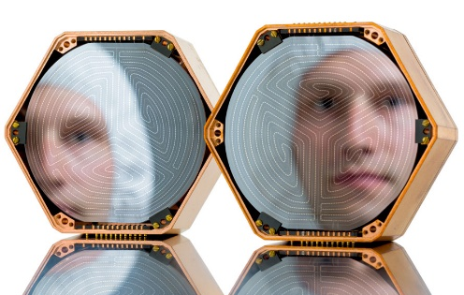
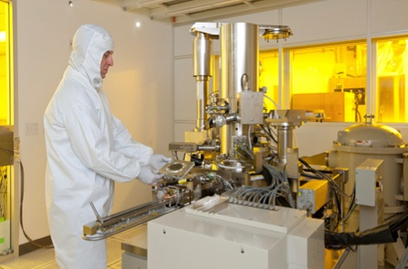
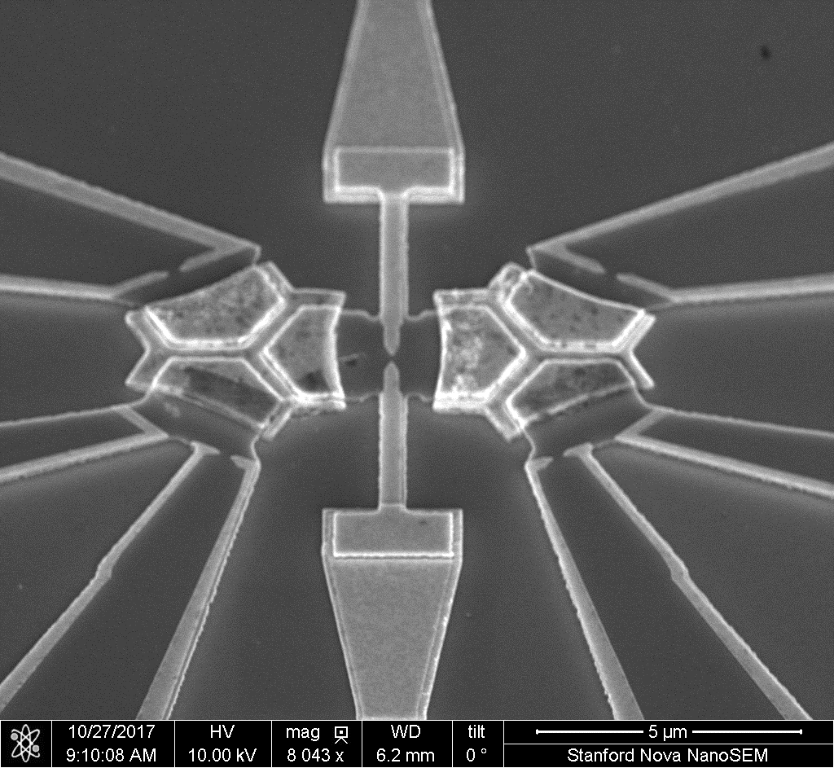
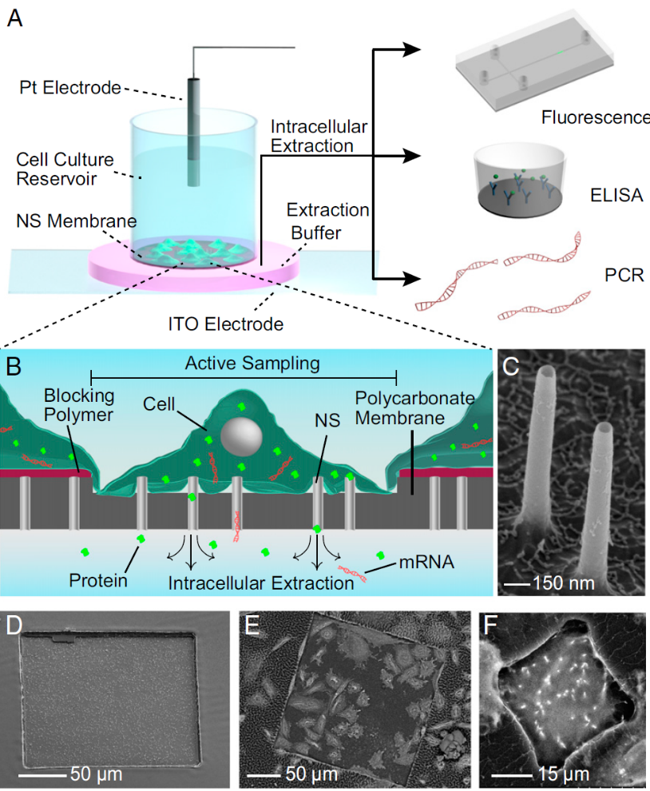
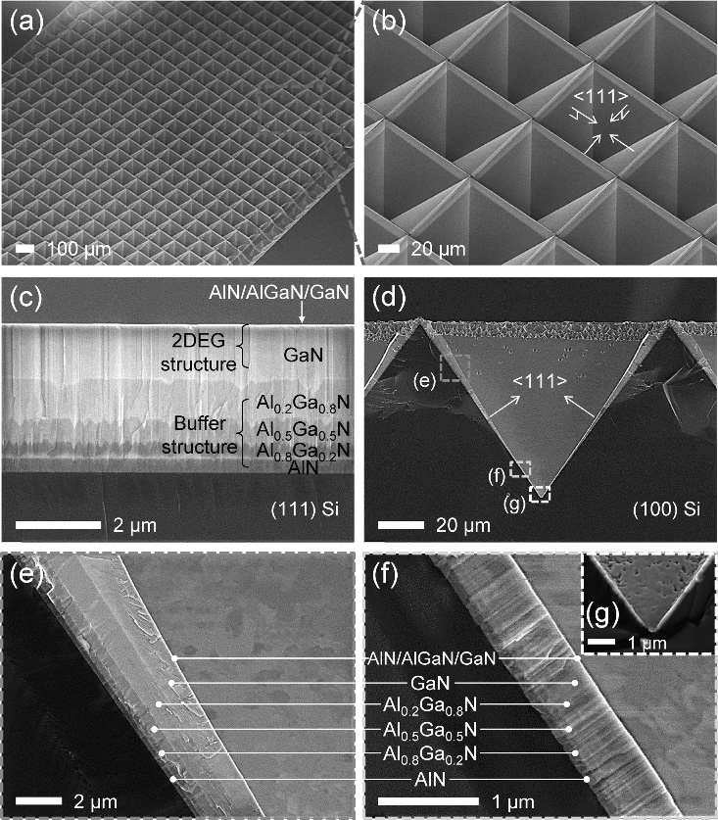
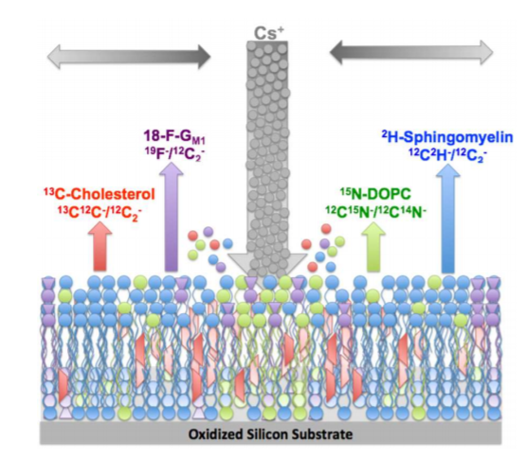
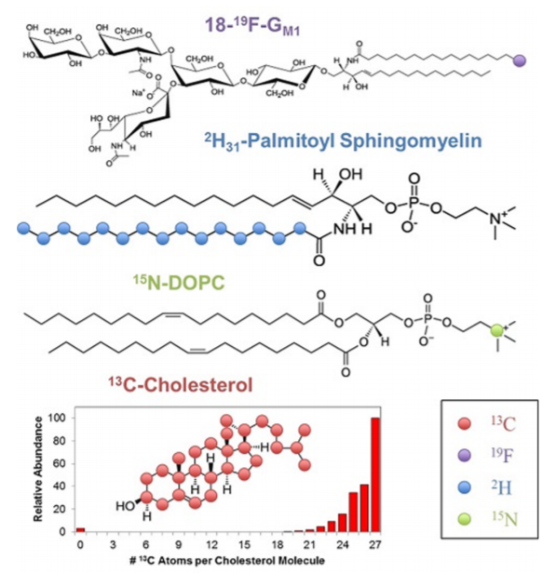
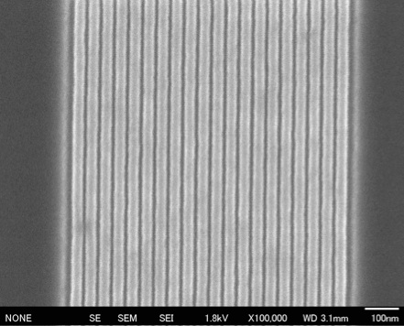
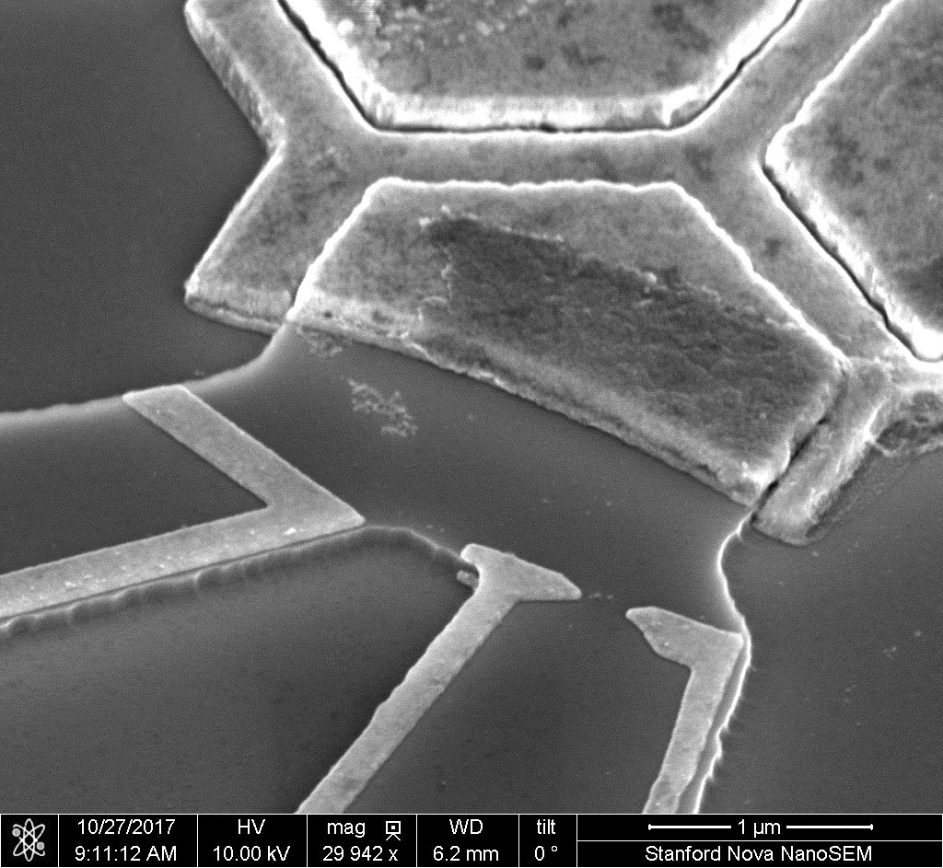
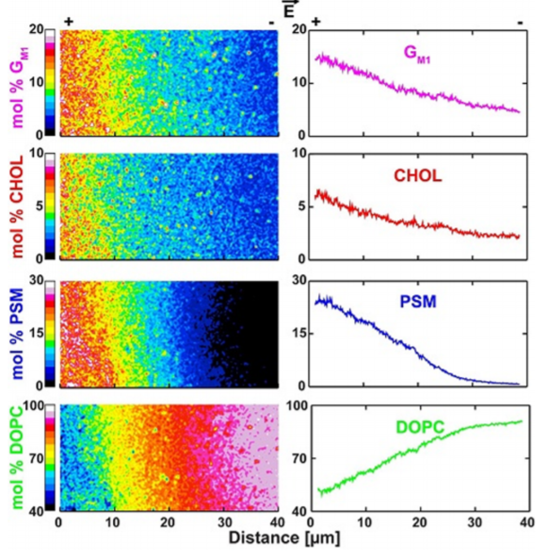
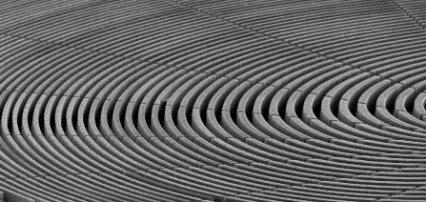
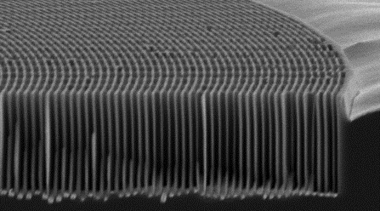
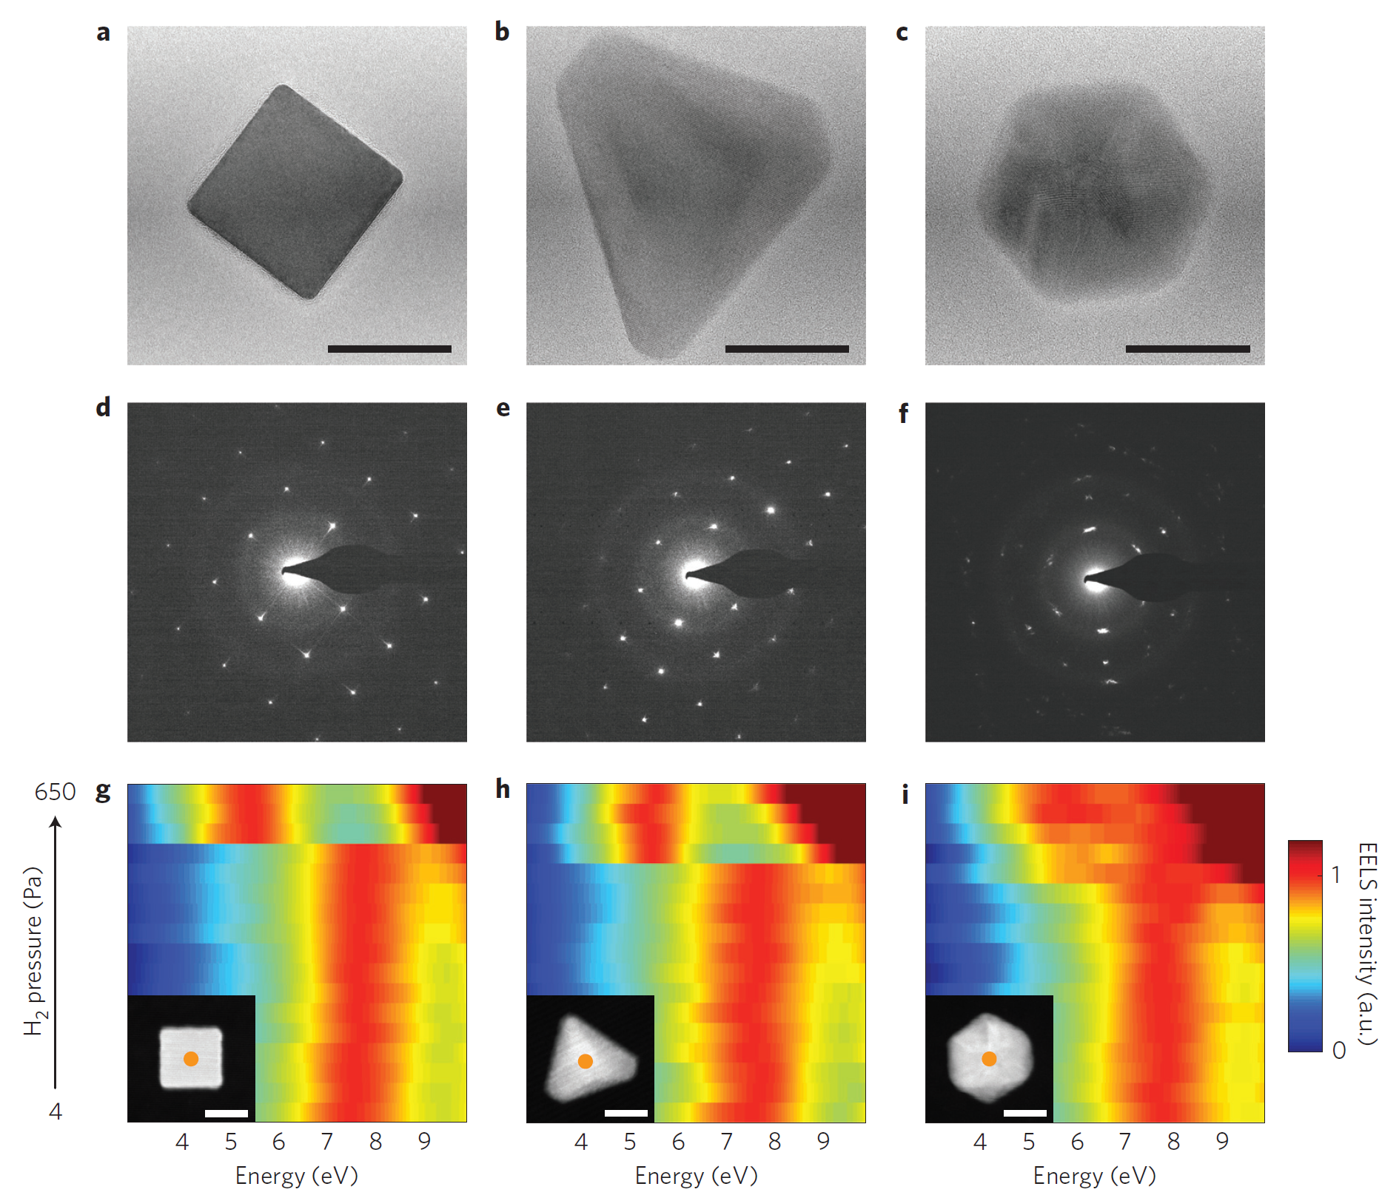
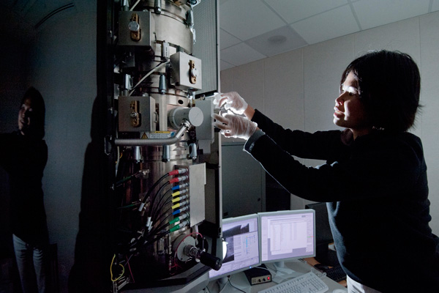
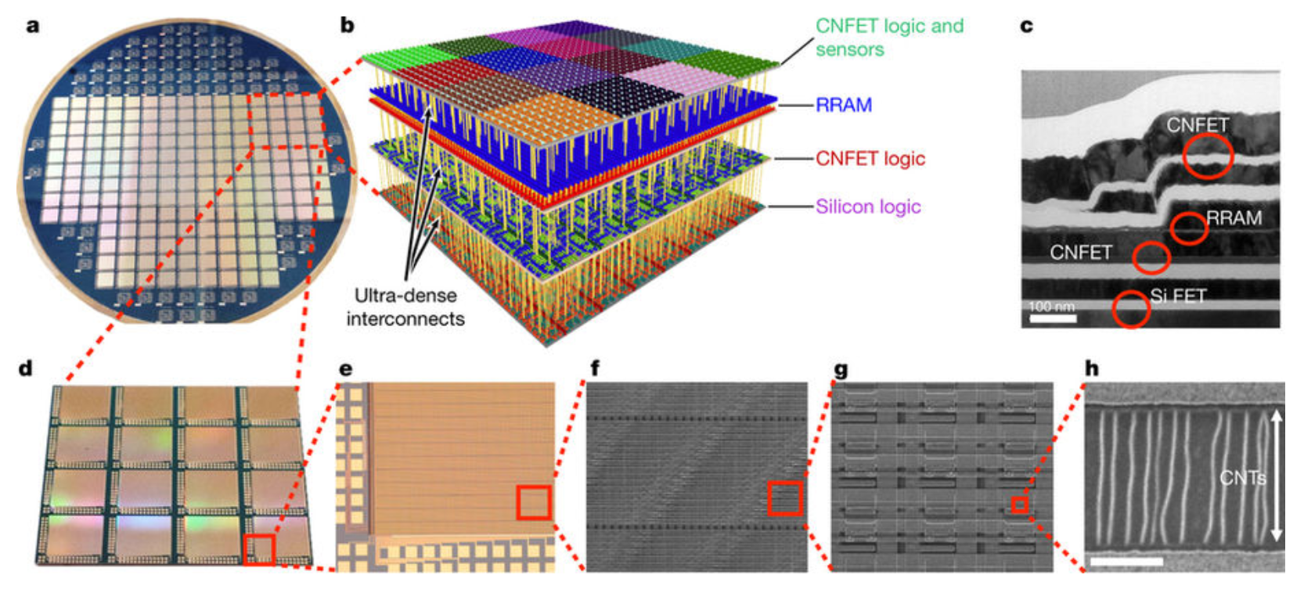
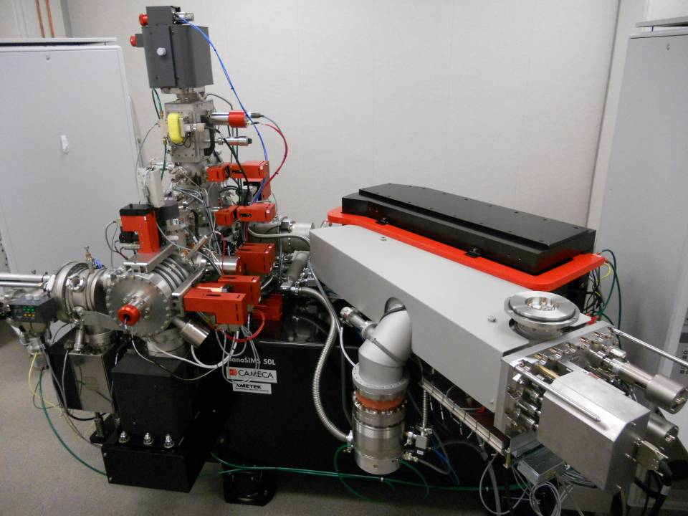
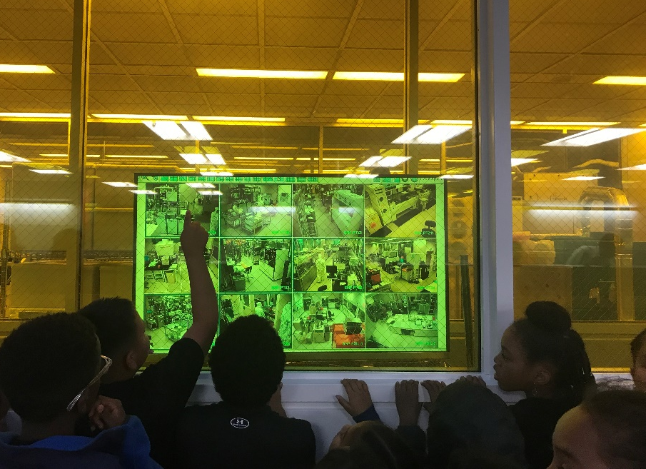
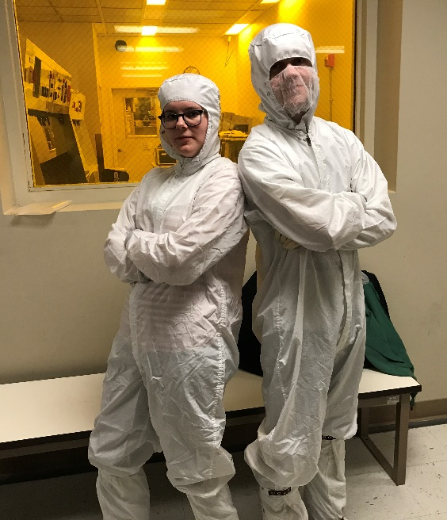
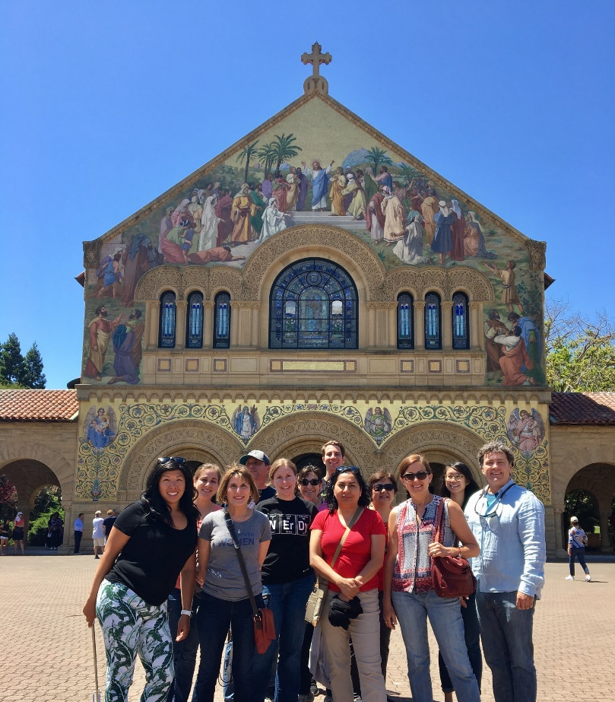
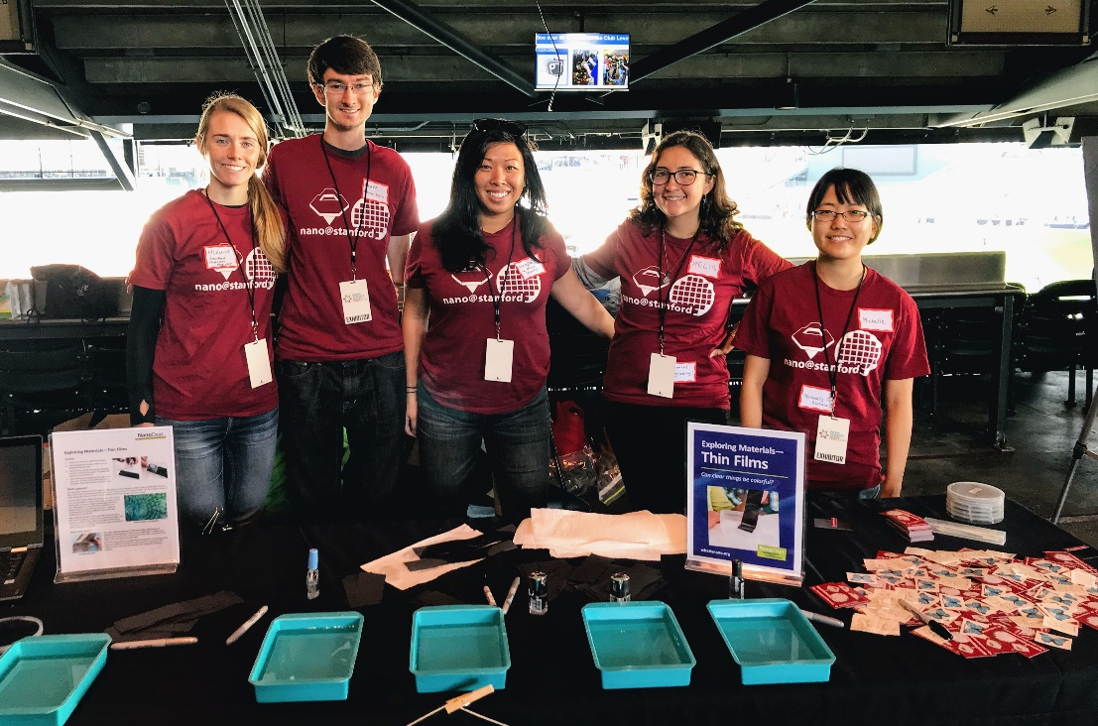
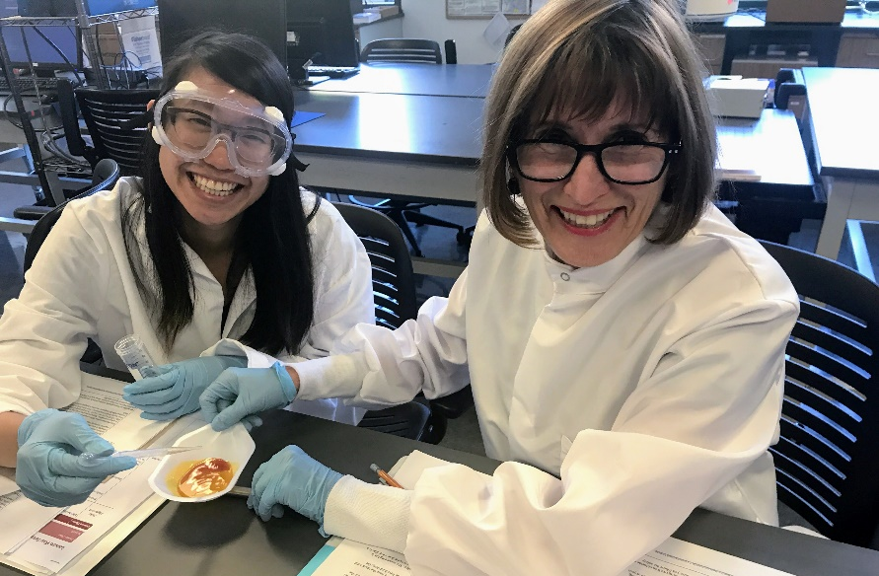
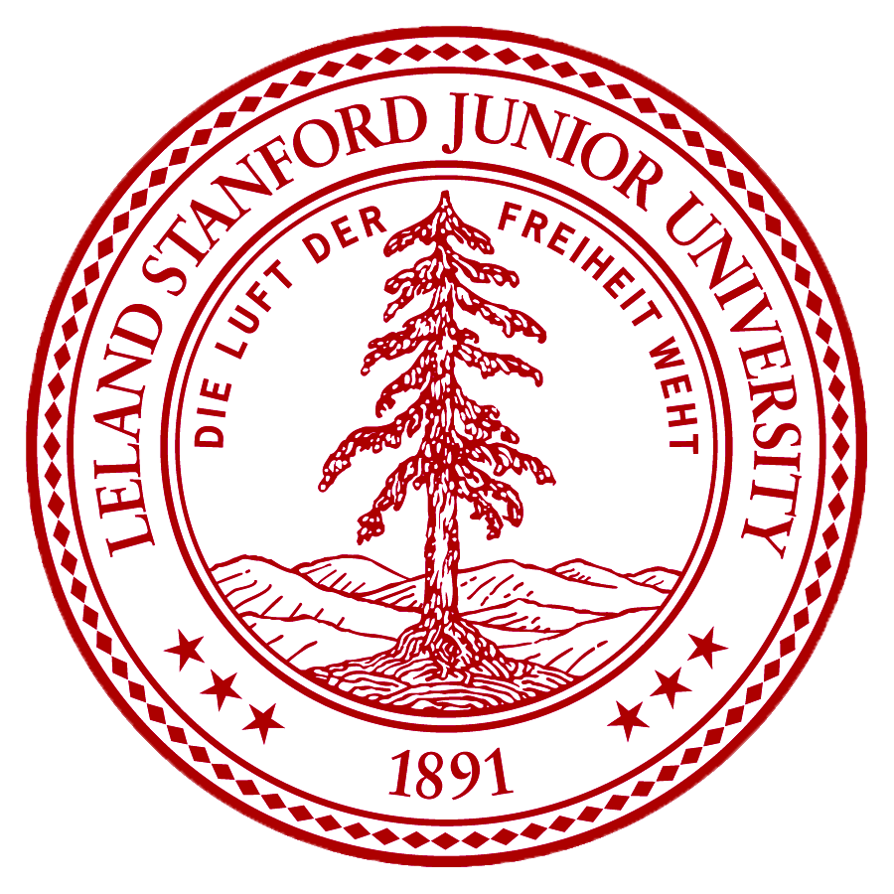
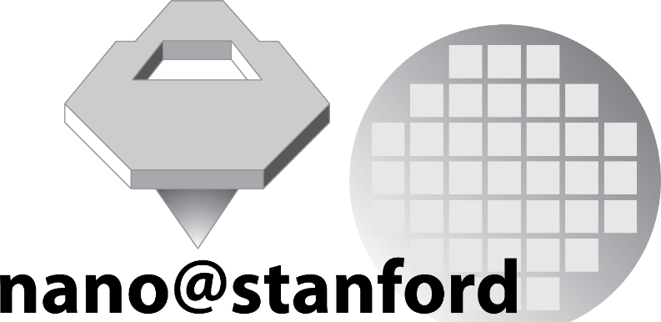
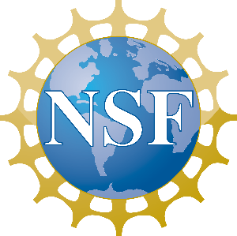
nano@stanford
National Nanotechnology Coordinated Infrastructure Site
http://nanolabs.stanford.edu
Introduction
The science and technology of the nanoscale is one of the most promising areas in science and engineering today. The ability to create materials and devices at the scale of one-billionth of a meter will have applications in every area of life, from more effective medicines to ultrafast communications and cleaner fuels. nano@stanford provides access to world-leading facilities and expertise in nanoscale science and engineering for internal users and for external users from academic, industrial, and government labs. Over 1,200 annual users take advantage of a comprehensive array of advanced nanofabrication and nanocharacterization tools available at the nano@stanford site.
The Labs
nano@stanford provides researchers access to instrumentation and staff experts organized under Nano Shared Facilities (SNSF), the Stanford Nanofabrication Facility (SNF), the Mineral Analysis Facility (MAF), and the Environmental Measurement Facility (EMF). Together these facilities feature:
~16,000 sqft fully equipped cleanroom facilities, including resources that are not routinely available, such as an MOCVD and advanced e-beam lithography
~15,000 sqft of characterization facilities, including SEM, TEM, FIB, XRD, SPM, XPS, X-ray microscope and unique tools such as a NanoSIMS, and a scanning SQUID microscope.
Research
nano@stanford supports a broad research portfolio spanning traditional nano areas as well as life science, medicine, and earth and environmental science.
A mesoscopic structure consisting of two coupled quantum dots to study the multi-impurity Kondo effect. Prof. Goldhaber-Gordon
A
B
100 kV JEOL e-beam, 40 nm grating with ~ 8 nm lines. Image: low voltage SEM image of polymer resist. Image courtesy of Dr. Tiberio (Stanford).
A quantum point contact leading up to a micron-sized ohmic contact to a GaAs/AlGaAs heterostructure
Optics and Nanostructures for Synchrotrons and FELs, Dr. A. Sakdinawat Group (SLAC/X-FEL). The outermost zone widths of the zone plate are 100 nm. Scale bar 2 μm
C
Non-destructive Cell Content Analysis Profs. Santiago, Wu, Melosh research groups
PNAS 114 (2017)
AlGaN/GaN heterojunction grown on 3D Si substrate using MOCVD
Prof. Senesky Appl. Phys. Lett. 108, (2016)
A) A cesium ion beam is rastered across a surface generating secondary ions (²H⁻ ,¹⁹F⁻,¹²C2⁻,¹²C ¹³C⁻, ¹²C 14N⁻, and ¹²C ¹⁵N⁻ )
B) Structures of labeled molecules used for NanoSIMS analysis of supported lipid bilayers
C) NanoSIMS images and corresponding concentration profiles of a patterned supported lipid bilayer after an electric field was applied prior to sample freezing.
Prof. Boxer J. Am.Chem.Soc (2016)
Structural characterization and EELS of individual palladium nanoparticles (Scale bars 20 nm)
Prof. Sinclair and Dionne, Nature Materials (2016)
3D nanosystem, Profs. Wong, Howe, Saraswat, and Mitra Nature 547 (2017)
Become A Lab Member
Education & Outreach
Education and outreach is an integral part of the nanofacilities and includes:
Training, consultation, and collaboration by our research staff in charge of instruments
Technical seminars and workshops
Field trips for K-12 students and educators
Summer educator workshop
Students visit the nanofacilities at Stanford and learn about fabrication and characterization tools. They also participate in a gowning activity.
nano@stanford is open to internal users as well as users from other institutions, national labs, or industry for any type of research and development activity acceptable within Stanford University Academic Research Policies and Procedures.
http://nanolabs.stanford.edu
Middle school teachers participate in a 1-week summer workshop learn a wide range of nanoscience concepts through tours, lectures, and experiments.
Remote activity between staff at Stanford and students in Sacramento. Students are able to experience life inside a cleanroom.
Lab members volunteer at the Bay Area Science Festival at AT&T Park in San Francisco, teaching hands-on educational activities about nanotechnology.
nano@stanford is supported by the National Science Foundation as part of the National Nanotechnology Coordinated Infrastructure under award ECCS-1542152.
Notes:
.

